Slide 1
Ending
Whither
By Jonathan Shiery

Slide 2
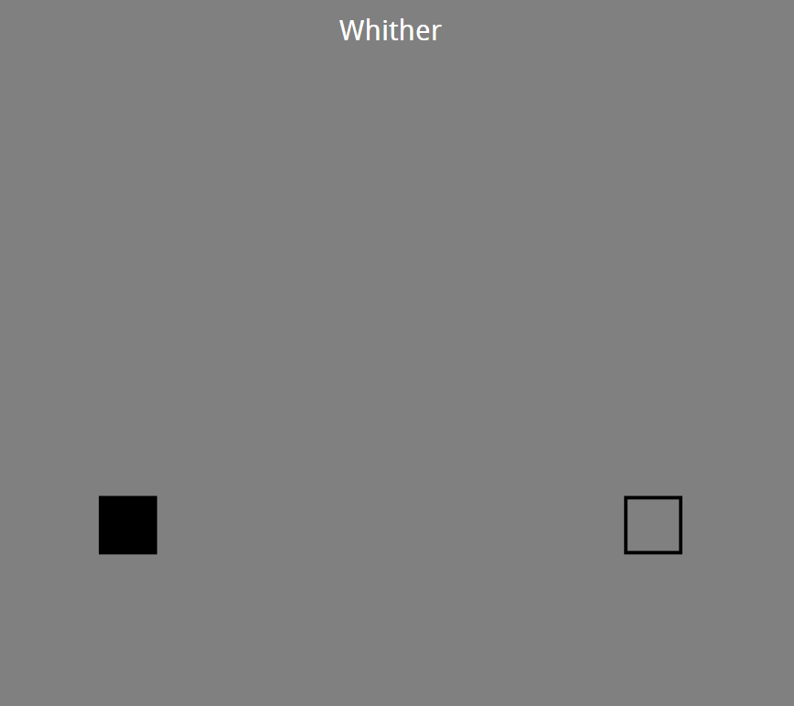
The Original Ending
Interpretation: No matter how hard you try to reach the goal, you might never be able to reach it.
Personally, I found it dissatisfying, simply because it’s too sudden.

Slide 3
Improving the Ending
Needs more buildup
Use a scrolling screen to increase the length of the level, while also keeping the grid size.
Do not have the final level play on repeat.
The goal actively moves away from you, while also disappearing.
Music fades lower and lower the farther in the level the player goes
By doing these modifications, I hope to tip the player off that this level is unbeatable.

Slide 4
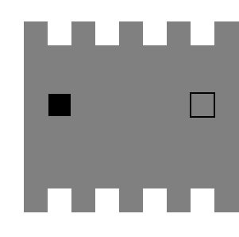

Slide 5
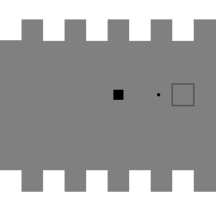

Slide 6
